Slide 1
AINT351: Machine Learning Lecture 2 More on distributions

Slide 2
Expected value
Discrete case:
The sample mean:
Continuous case:

Slide 3
Expected value of uniform distribution
Consider uniform distribution
p(x)
1
x
1
Expected value is given by:

Slide 4
Variance
Discrete case:
The sample variance:
Continuous case:

Slide 5
Covariance: joint probability
The covariance measures the strength of the linear relationship between two variables
The covariance us given by:
The sample covariance:

Slide 6
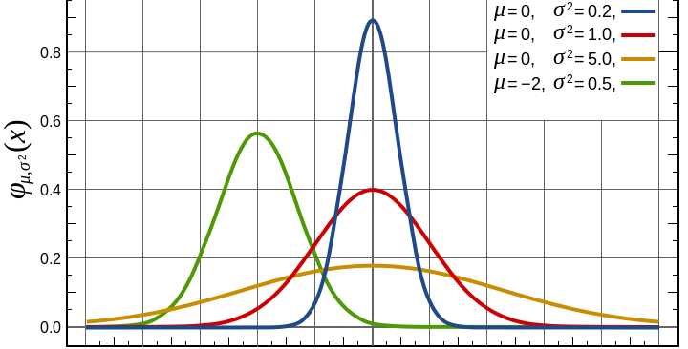
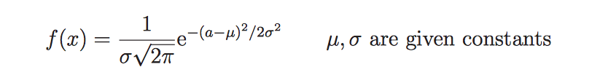
Normal distributions
Quite often continuous values will be characterized by a Normal (or Gaussian) distribution
Sufficient statistics:
mean
standard deviation

Slide 7
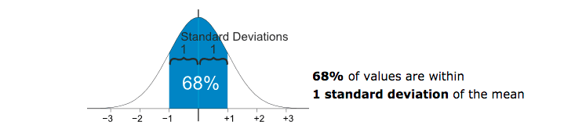
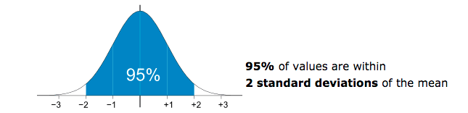
Effect of standard deviation

Slide 8
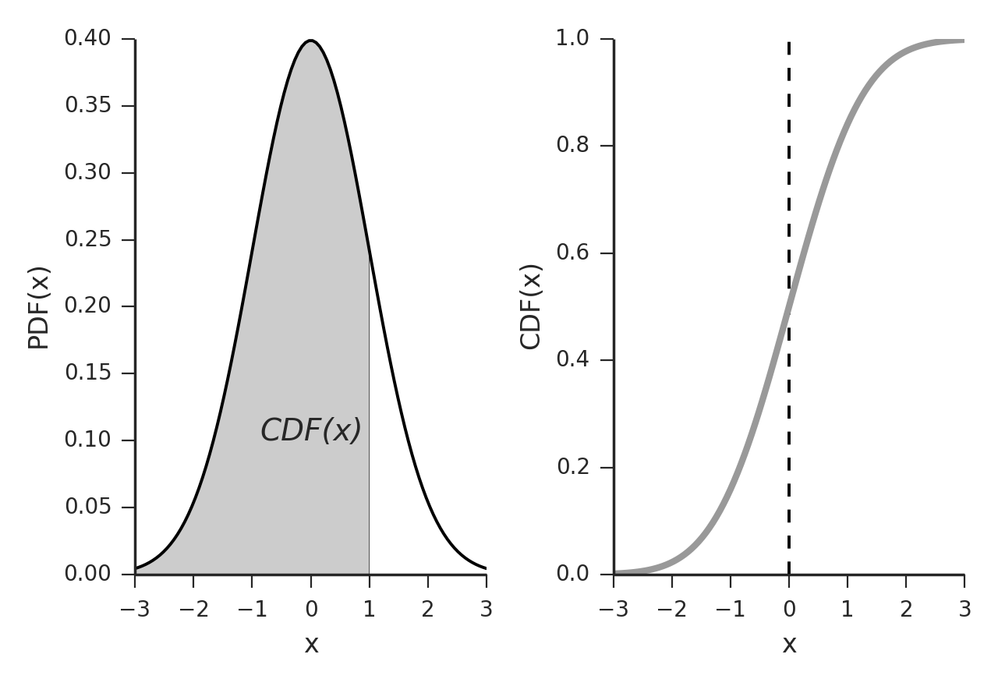
Cumulative Distribution Function
Cumulative distribution function
For a continuous random variable X the cumulative distribution function, CDF(x) represents the area under the probability density function P(x) to the left of X

Slide 9


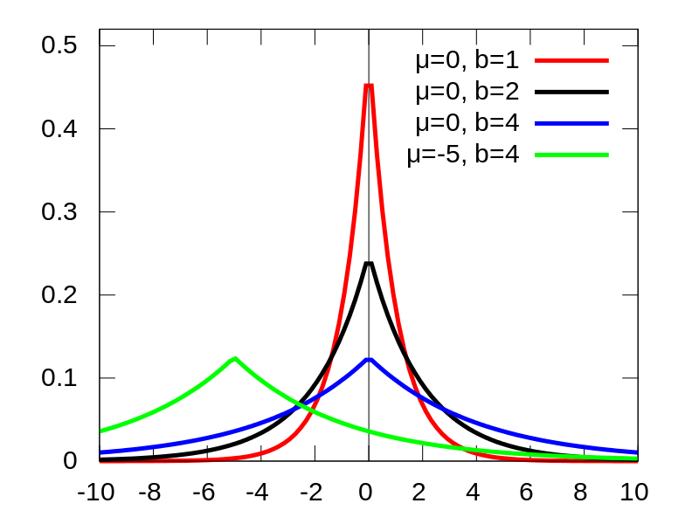
Laplacian distribution
Reminiscent of the normal distribution

Slide 10

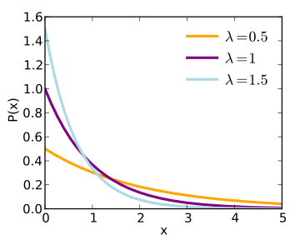
Exponential distribution

Slide 11
Exponential distribution
Given P(x) = e^{-x}
What is the probability of x falling within 1 to 2 ?
p(x)=e^{-x}
P(1 <= x <=2) corresponds to area under distribution between 1 and 2
1
x
1
2

Slide 12
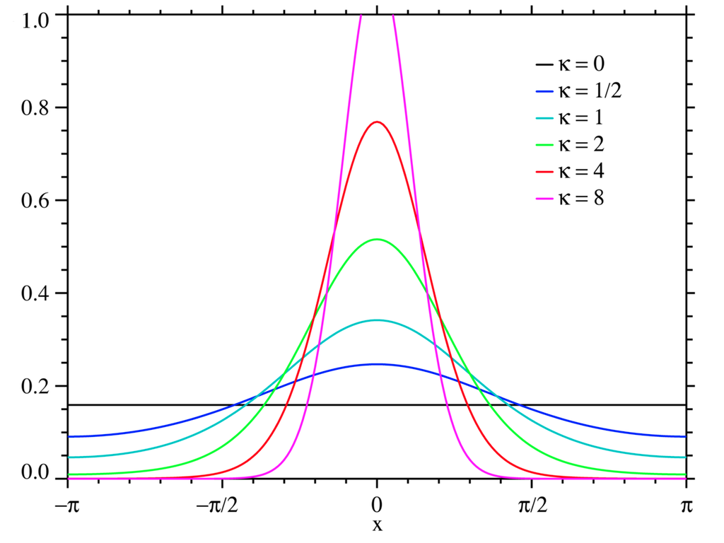
Von Mises distribution
The von Mises function is a circular continuous probability distribution. It is given by
where
θ is angle
μ and k are the mean and width parameters of the von Mises function respectively
I₀(k) is a Bessel function of order zero
Note that 1/k is analogous to the Gaussian distribution variance σ²
Useful for modeling circular data – e.g. angular tuning

Slide 13

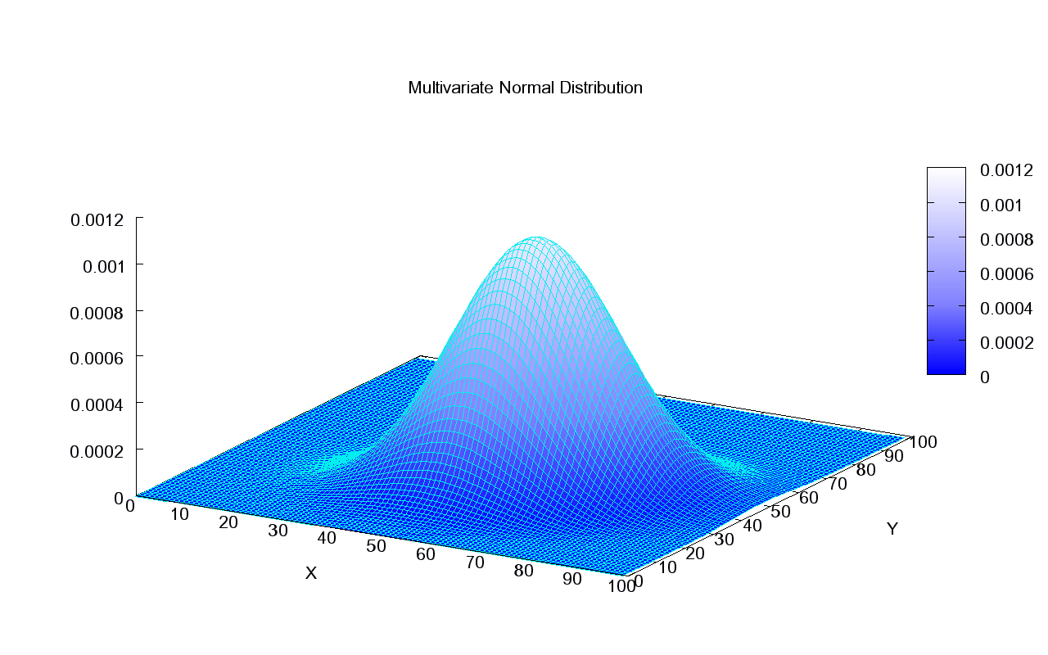
Multi dimensional distributions
Can have N dimensional distributions
for Normal case

Slide 14
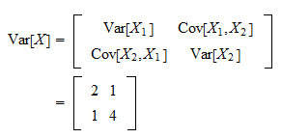
Interpreting covariance
If we calculate the covariance between two random variables
If cov(X,Y) > 0 -> X and Y are positively correlated
If cov(X,Y) < 0 -> X and Y are inversely correlated
If cov(X,Y) = 0 -> X and Y are independent
For example

Slide 15
AINT351: Machine Learning Lecture 2 Some more probability

Slide 16

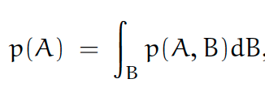
Sum rule of probability theory
B₂
Sum rule states that
B₅
B₃
B₄
A
B₁
B₇
B₆
Sometimes called marginalization

Slide 17
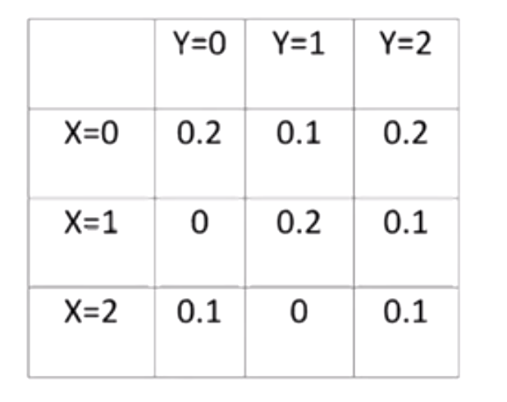
Marginalization example
P(x=0) = 0.2 + 0.1 + 0.2 = 0.5
P(x=1) = 0 + 0.2 + 0.1 = 0.3
P(x=2) = 0.1 + 0 + 0.1 = 0.2

Slide 18
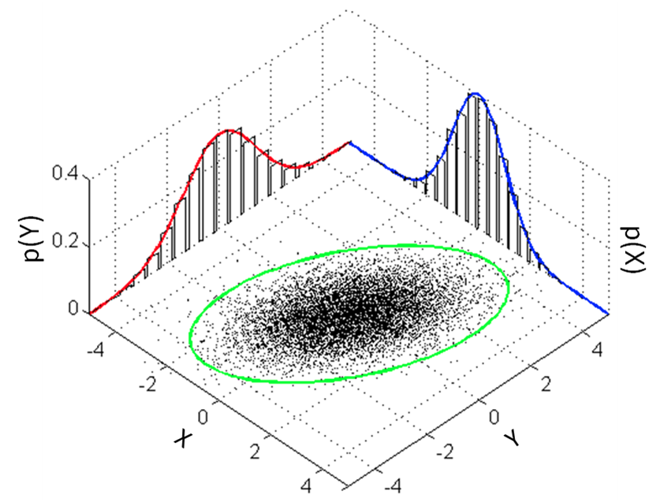
Marginal distributions of a 2D distribution
Samples from a bivariate normal distribution
The marginal distributions are shown in red and blue
The marginal distribution of X is also approximated by creating a histogram of the X coordinates without consideration of the Y coordinates

Slide 19

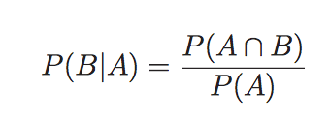
Conditional probability: Bayes rule
P (A ∩ B) is the probability of A and B happening
Can be written P(A, B) - the joint distribution of A and B
= the probability of A happening multiplied by the probability of B happening given that A has happened

Slide 20
Conditional probability
If A and B are NOT independent events then
P (A ∩ B) = P (A) . P (B|A)
This relationship is always true!
Pick two card from a pack at the same time. What is the chance both are aces?
P(pick1 = ace) = 4/52
P(pick2 = ace) = 3/51
P(pick1 = ace and pick2 = ace) = 4/52 * 3/51

Slide 21
Conditional probability
If A and B are independent events then
P (A ∩ B) = P (A) . P (B)
This relationship is only true is A and B are independent!
Role a dice twice – NB: first roll does not affect second
What is the probability of getting six twice?
P(run 1 = 6) = 1/6
P(run 2 = 6) = 1/6
P(run 1 = 6 and run 2 = 6) = 1/6 * 1/6

Slide 22
Product rule of probability
Product rule state that
Leads to Bayes rule
If A and B are independent

Slide 23
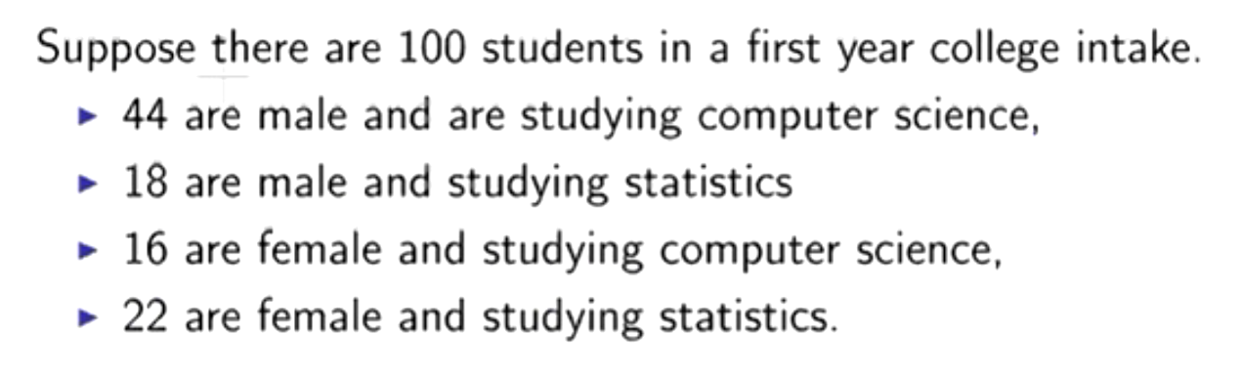
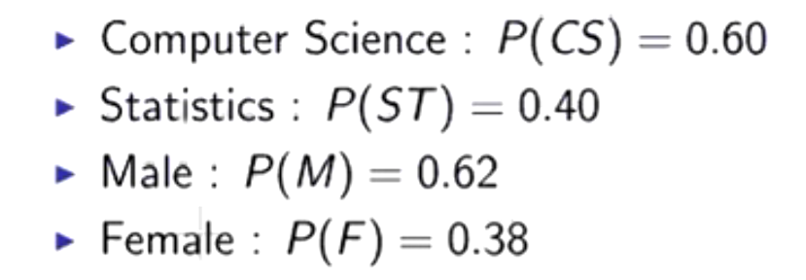
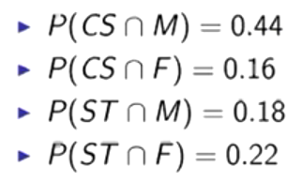
Example conditional probabilities

Slide 24
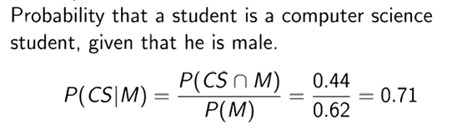
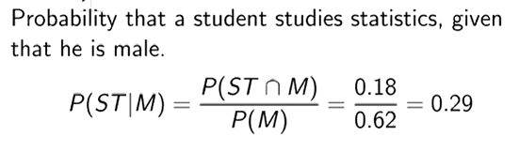
Apply Bayes rule

Slide 25
AINT351: Machine Learning Lecture 2 Gradient descent

Slide 26
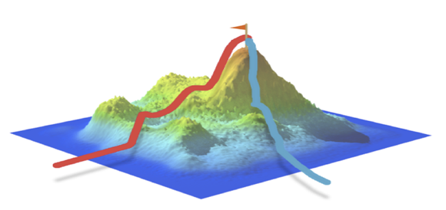
Gradient descent
How can we get to the top of a hill?
We follow the gradient!
How do we know we are at a peak?
It goes down on both sides!
Same thing is true for mathematical functions

Slide 27
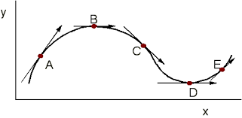
Gradient of a curve
Gradient is the slope of a curve or surface
Going up hill it is +ve, going downhill–ve At maxima it is zero e.g. B

Slide 28
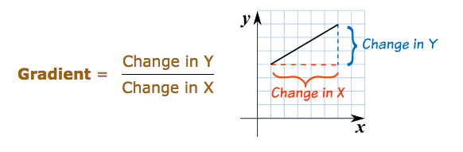
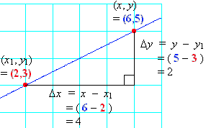
Gradient of a straight line

Slide 29
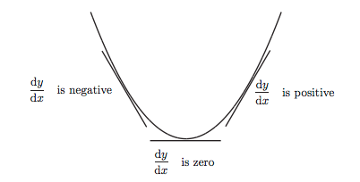
Finding the minimum of a function

Slide 30
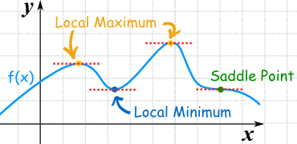
Maxima and minima
At these points dy/dy = 0

Slide 31
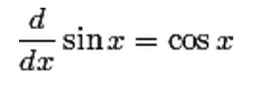
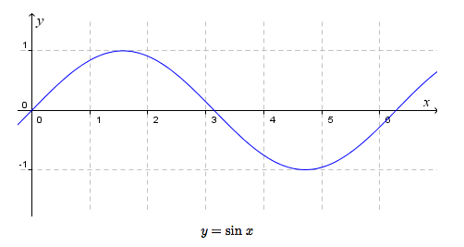
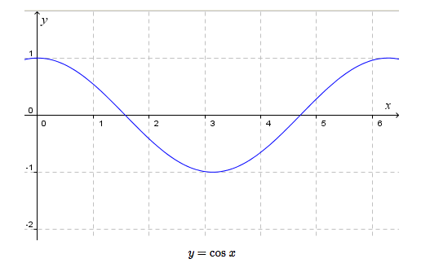
Finding minima analytically

Slide 32
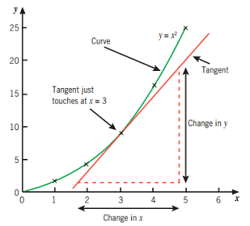
Gradient of a curve

Slide 33
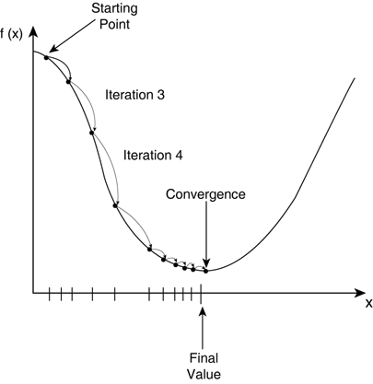
Iterative gradient decent
Find minimum of a function
Move downwards in direction of gradient

Slide 34
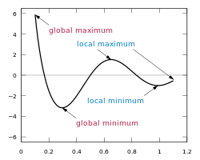
Local maxima and minima
Can be local minima as well as global minima
Same for maxima
Gradient descent can get
stuck in local minima!

Slide 35
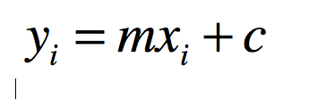
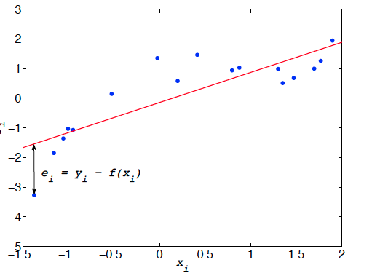
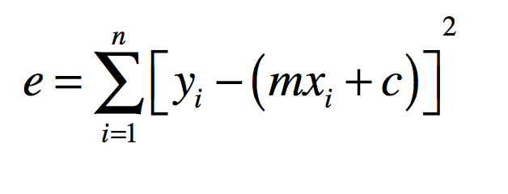
Least squares fitting
We want to fit a straight line to data measurements
Equation for a straight line in single dimension is:
Sum error over all points

Slide 36
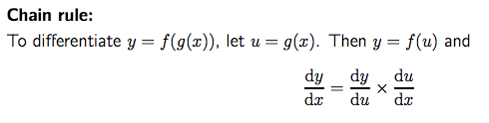
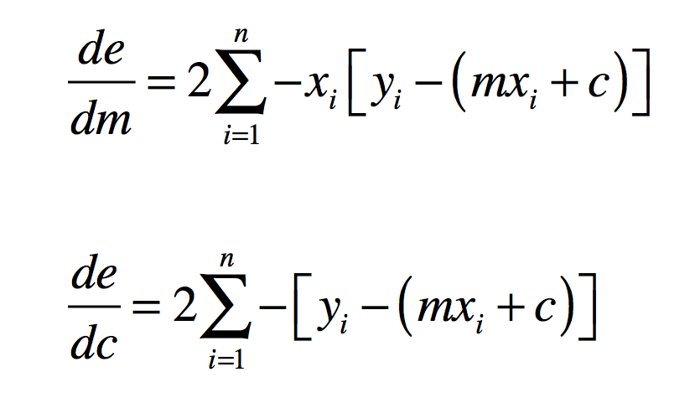
Least squares fitting
We can differentiate the error with respect to m to give the gradient
Looking at the terms rather than the sum

Slide 37
Least squares fitting
We can differentiate the error with respect to c to give the gradient
This leads to

Slide 38
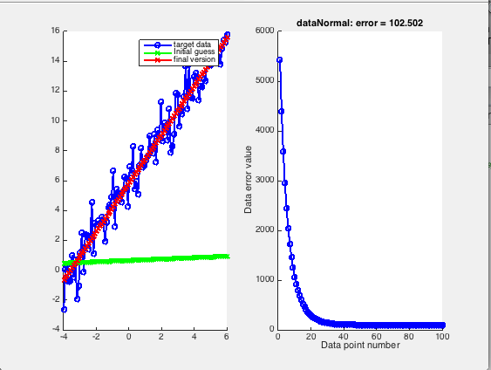
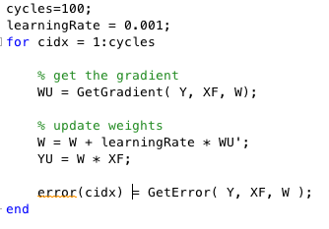
Matlab gradient descent
We can follow there gradient down to find the local minimum that fits the parameters to out dataset!

Slide 39
AINT351: Machine Learning Lecture 2 Matlab matrices

Slide 40
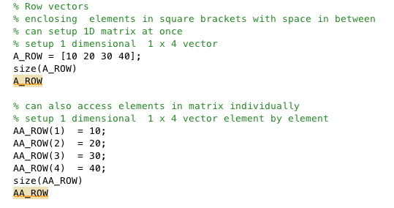
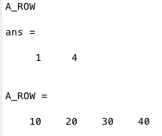
Matrices in Matlab

Slide 41
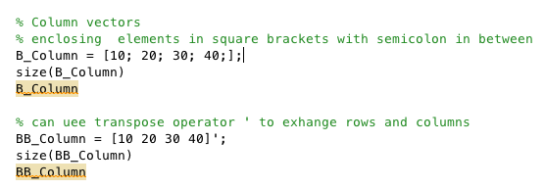
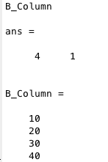
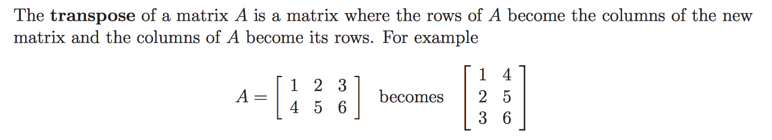
Matrices in Matlab

Slide 42

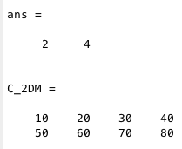
Matrices in Matlab

Slide 43
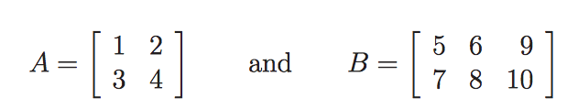
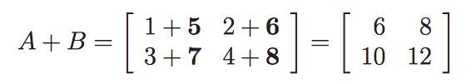
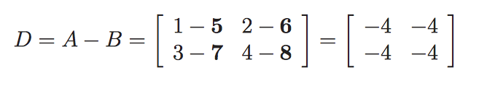
Adding matrices
Add the elements
Subtract the elements

Slide 44
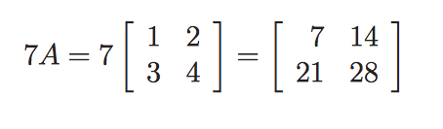
Multiplication of a matrix by a number

Slide 45
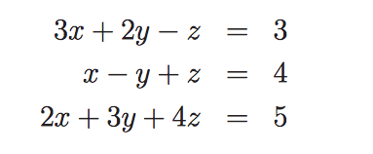

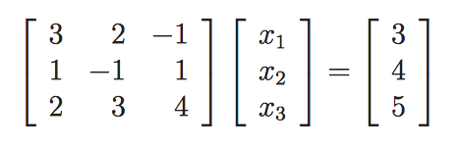

Using matrices to represent equations
Can write equations as
Where

Slide 46

Multiplying row and column matrices
Multiply rows by columns

Slide 47


Multiplying 2x2 matrices

Slide 48

Multiplying 3x3 matrices

Slide 49


Multiplying non-square matrices

Slide 50


2D rotation matrix
Rotate 2 dimensional point (x,y) by angle θ

Slide 51


Rotate data points in Matlab

Slide 52
Suggested reading
http://www.mathworks.co.uk/help/pdf_doc/matlab/getstart.pdf
J.M. Maciejowski, Getting started with MATLAB.
Christopher M. Bishop: Pattern Recognition and Machine Learning, Springer (2006)
D.J.C. MacKay: Information Theory, Inference and Learning Algorithms, Cambridge University Press

Slide 53

Acknowledgements
http://nucinkis-lab.cc.ic.ac.uk/HELM/helm_workbooks.html
Stats-Lab Dublin

